Slide 1




Hello Classmates!
All About OPERATING SYSTEM
A PRESENTATION TO INTRODUCE WHY AND HOW OPERATING SYSTEM?

Slide 2
WHAT IS SYSTEM ADMINISTRATION?
SYSTEM ADMINISTRATION REFERS TO THE MANAGEMENT,
CONFIGURATION, AND MAINTENANCE OF COMPUTER SYSTEMS AND NETWORKS TO ENSURE THEY FUNCTION EFFICIENTLY.
ROLE OF A SYSTEM ADMINISTRATOR
A PROFESSIONAL RESPONSIBLE FOR THE UPKEEP, CONFIGURATION, AND RELIABLE OPERATION OF COMPUTER SYSTEMS, ESPECIALLY MULTI-USER COMPUTERS LIKE SERVERS.

Slide 3

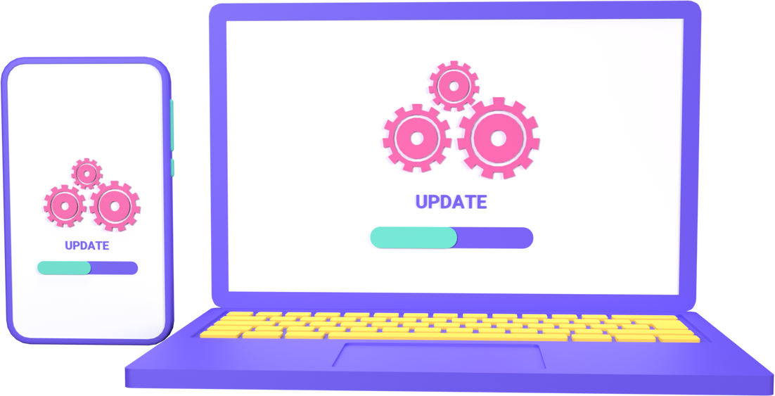
Operating System
Did You Know?
An Operating System (OS) is the main program in a computer.
It helps the computer parts (like the screen, keyboard, and memory) talk to each other.
The OS makes sure apps (like games or videos) work properly.
It helps keep your computer safe and running well.
Without an OS, your computer wouldn’t know how to do anything!

Slide 4

HISTORY OF OPERATING SYSTEM

Slide 5
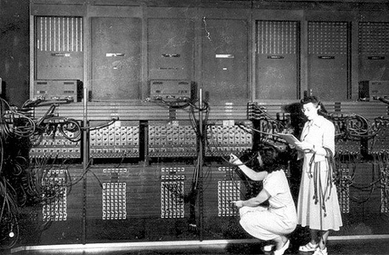
1950s - The Birth of Operating Systems Early Days
Computers were operated manually, with no operating system. Programs were loaded one at a time. Batch Processing: IBM's General Motors Research Laboratory created the first OS in the mid-1950s, which ran jobs in batches.

Slide 6
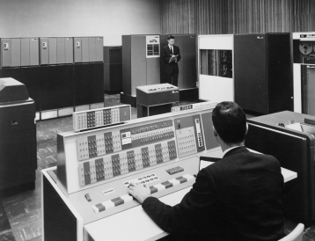
1960s - Time-Sharing and Multitasking Multics (1965)
A pioneering OS that introduced time-sharing, allowing multiple users to interact with a computer at once. UNIX (1969): Developed at Bell Labs, it became influential for its simplicity and portability. It laid the foundation for many modern OS.

Slide 7
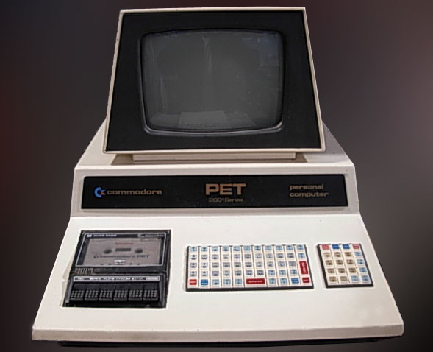
1970s - Personal Computing Revolution CP/M (1974)
An early OS for personal computers, widely used before the rise of MS-DOS. Apple DOS (1978): Apple's first OS for the Apple II series of personal computers.

Slide 8
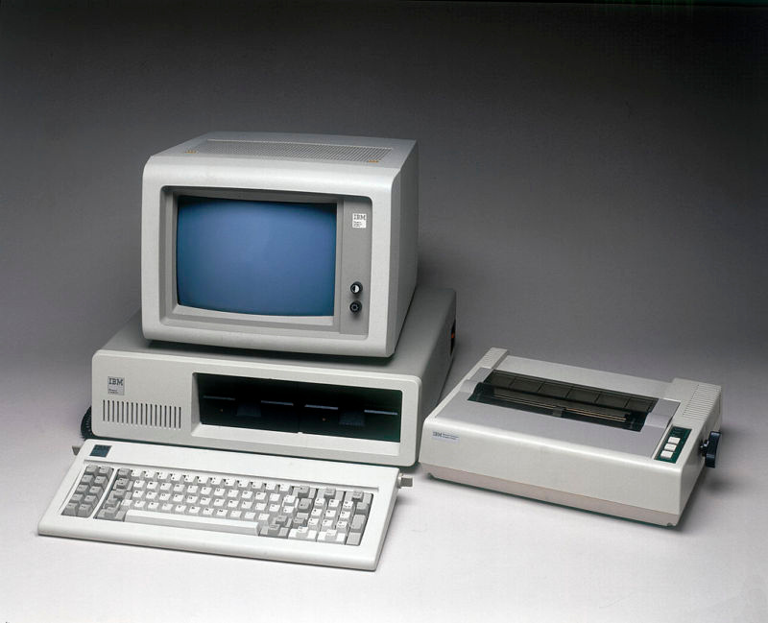
1980s - The Rise of DOS and Windows MS-DOS (1981)
Developed by Microsoft for IBM PCs, it became the dominant OS for PCs throughout the 80s. Windows (1985): Microsoft introduced Windows as a graphical extension for MS-DOS, providing a user-friendly interface.

Slide 9
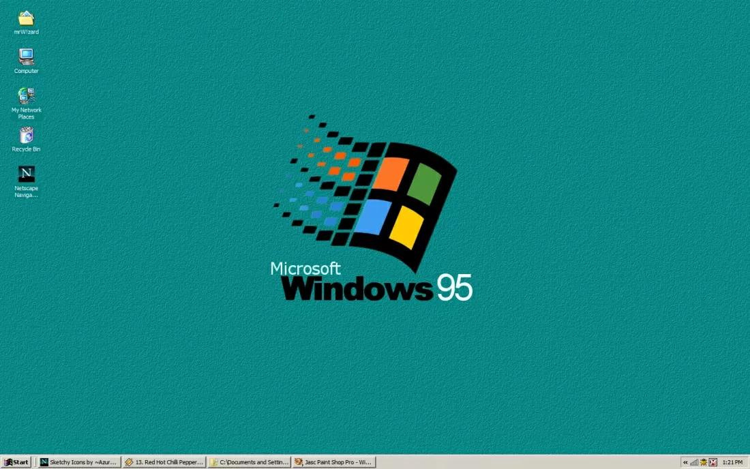
1990s - Graphical User Interface (GUI) Era Windows 95 (1995)
A landmark release that integrated MS-DOS with a GUI, making it user-friendly for the masses. Linux (1991): Open-source OS inspired by UNIX, offering flexibility and security for developers and server systems.

Slide 10
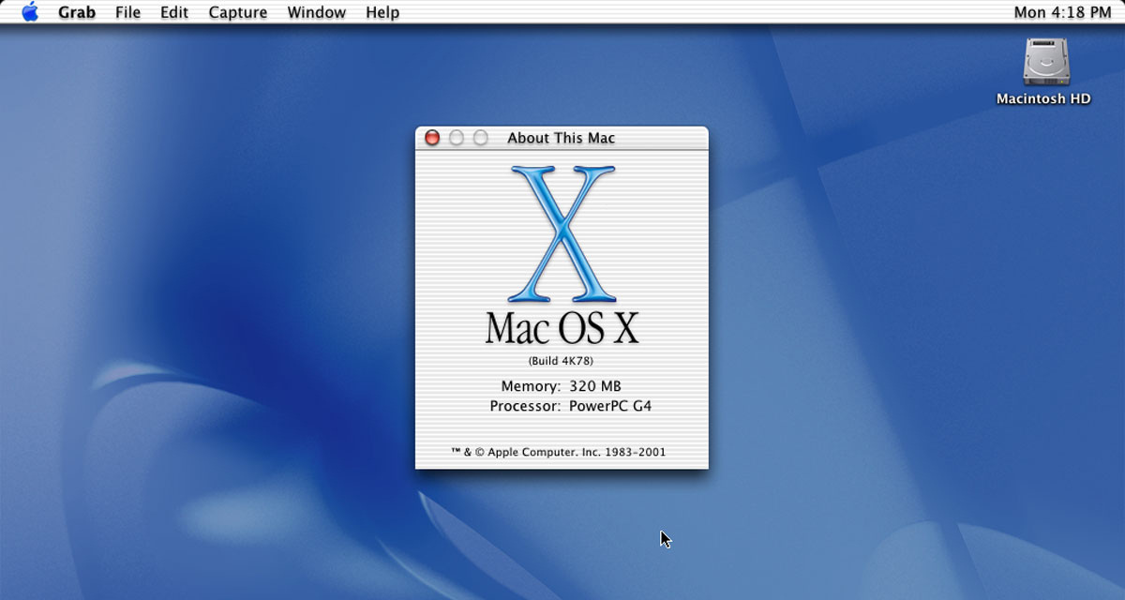
2000s - Modern OS Era Mac OS X (2001)
Apple launched a UNIX-based OS with a sleek user interface, now known as macOS. Windows XP (2001): Widely praised for stability and ease of use, it became one of Microsoft's most successful OS releases.

Slide 11

2010s - Mobile and Cloud Computing Android (2008)
Google's OS for mobile devices, based on Linux, now dominates the smartphone market. iOS (2007): Apple's OS for iPhones and iPads, IS known for its seamless integration with Apple's hardware ecosystem.

Slide 12
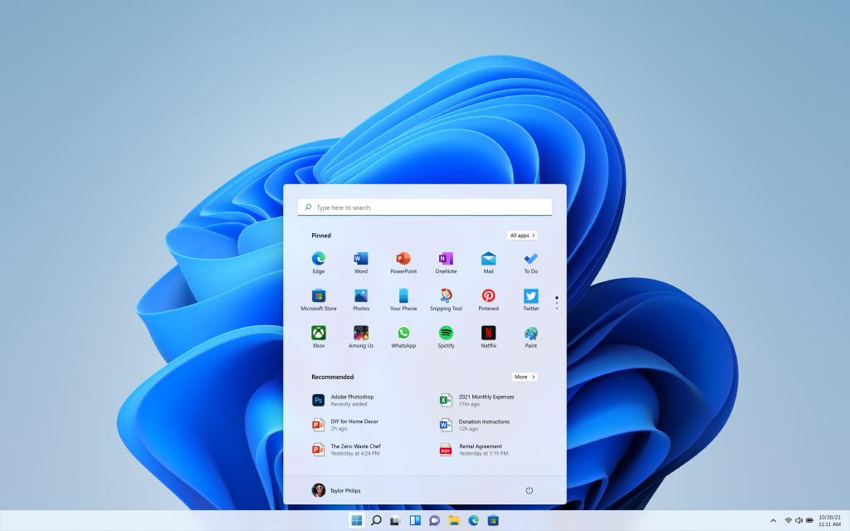
2020s - The Future of Operating Systems Windows 11 (2021)
A modernized version of Windows with better touch support, new features for productivity, and better gaming experiences. Cloud-Based OS: With more services moving to the cloud, operating systems may rely more on remote servers rather than local computing power.

Slide 13

Common operating systems

Slide 14
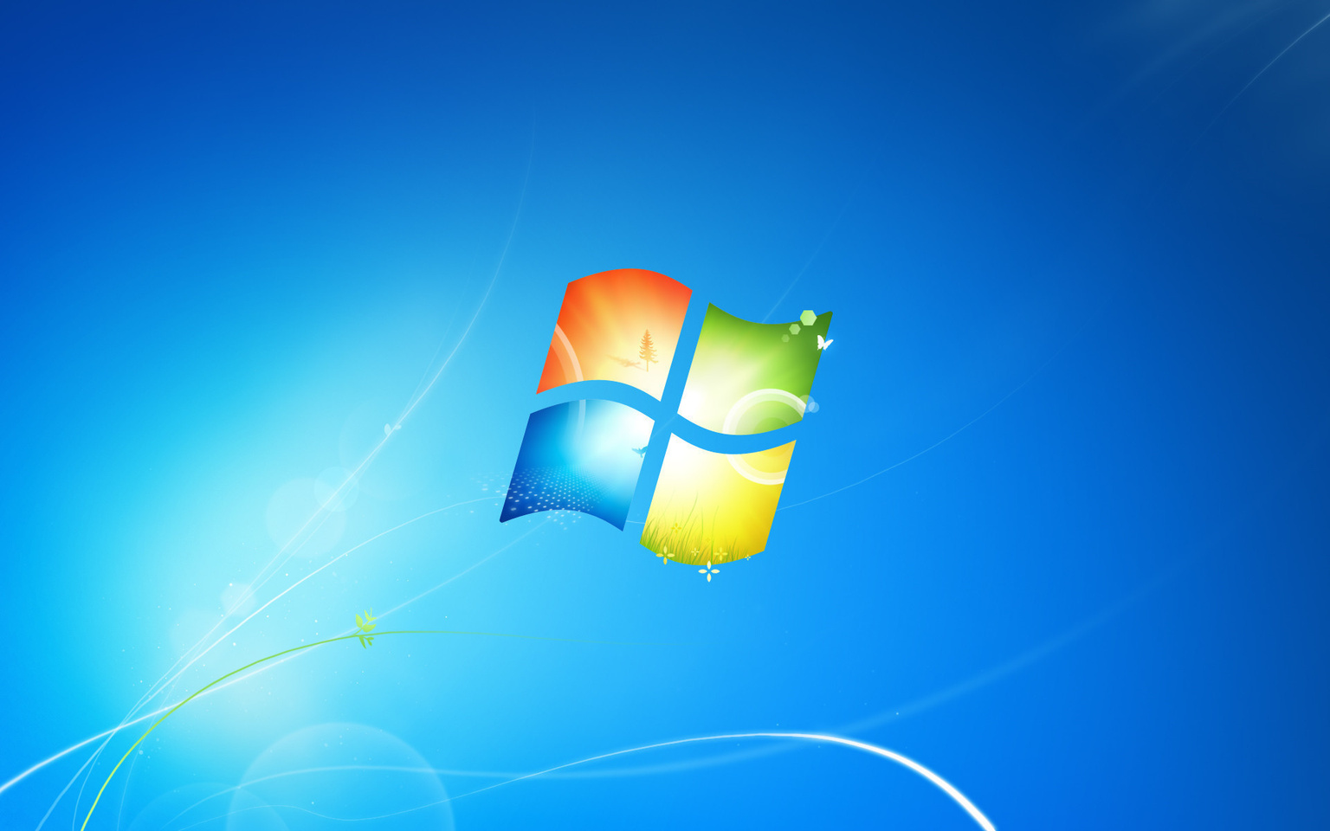
Microsoft Windows
Created by Microsoft, Microsoft Windows is one of the most popular proprietary operating systems for computers in the world. Most personal computers come preloaded with a version of Microsoft Windows. One downside of Windows is that compatibility with mobile phones has been problematic.

Slide 15
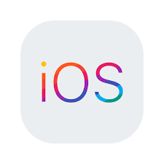
Apple iOS
Apple iOS from Apple is used on smartphones and tablets manufactured by the same company. Users of this system have access to hundreds of applications. The operating system offers strong encryption capabilities to control unauthorized access to users' private data.

Slide 16

Google Android
Android from Google is the most popular operating system in the world. It's mainly used on tablets and smartphones. It also runs on devices made by other manufacturers. Users have access to numerous mobile applications available on the Google Play Store.

Slide 17
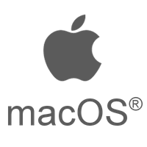
Apple macOS
Developed by Apple, this proprietary operating system, known as macOS (formerly OS X), runs on Apple’s personal computers and desktops. All Apple and Macintosh computers come with the latest version of macOS pre-installed. Its reputation for minimizing bugs and defending against hackers contributes to its popularity among users.

Slide 18

Linux
Created by Finnish programmer Linus Torvalds, Linux is now developed collaboratively by programmers worldwide who contribute updates to the central kernel software. It is widely used by programmers and corporate servers and is available for free online.

Slide 19
Role of Operating Systems in Management and Administration:

Slide 20
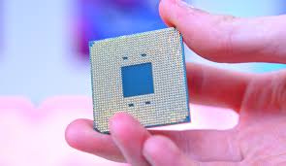
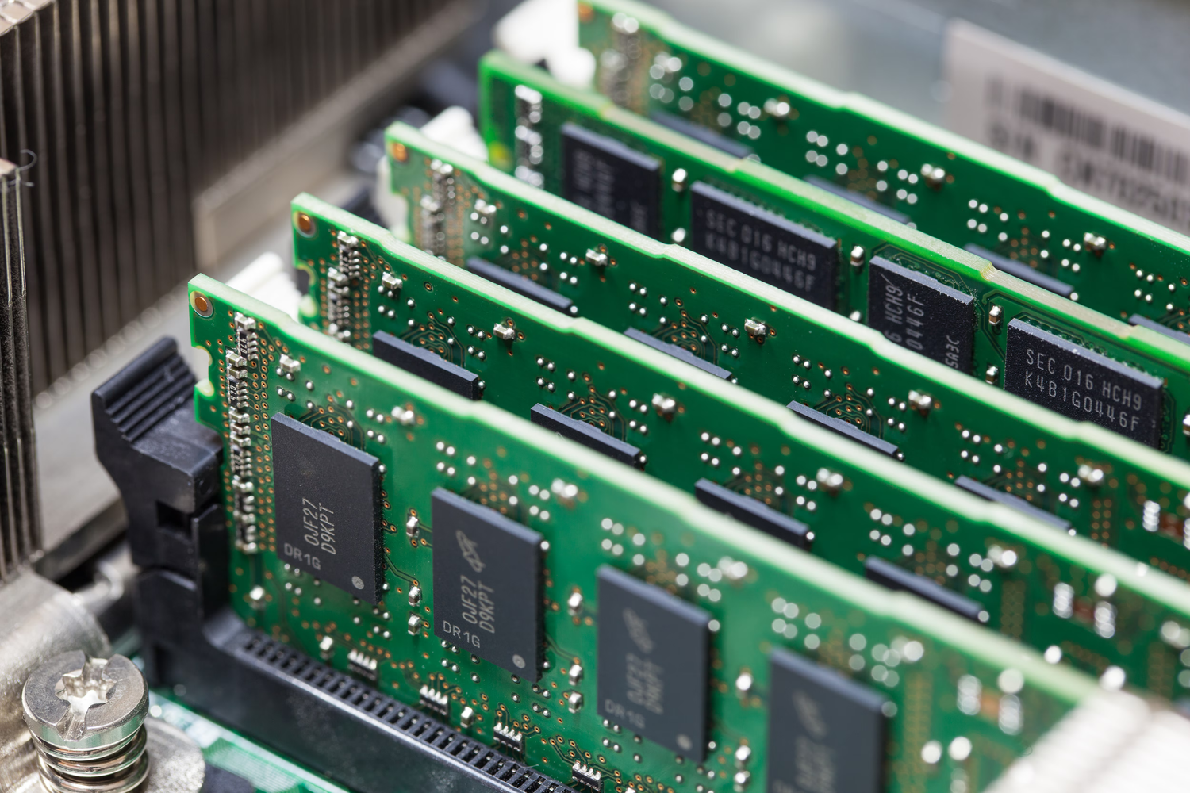

2.1 RESOURCE MANAGEMENT
Operating systems manage various resources, including:
CPU:
Scheduling processes and managing multitasking.
Memory:
Allocating and freeing memory as required by programs.

Slide 21
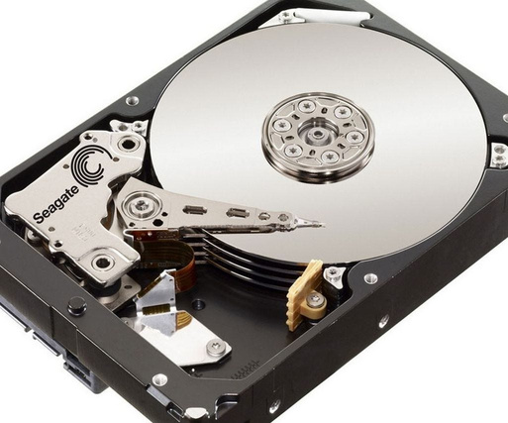
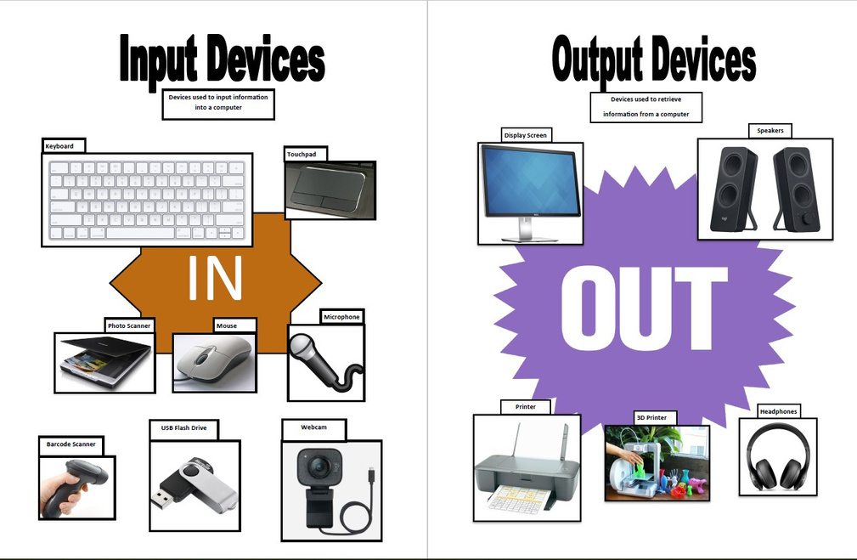
2.1 RESOURCE MANAGEMENT
Operating systems manage various resources, including:
Storage:
Managing data storage and retrieval on disks.
Input/Output Devices:
Handling communication between hardware and software.

Slide 22


2.2 User Management
Operating systems allow multiple users to share system resources while ensuring security through:
User accounts and authentication: Managing user permissions and access rights.
Session management: Ensuring that users can operate independently without interference.

Slide 23
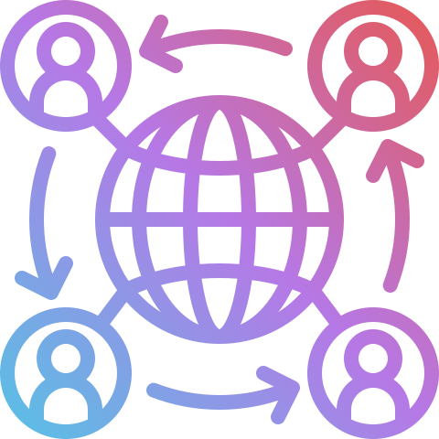
2.3 Process Management
The OS is responsible for:
Creating and managing processes: Starting and terminating processes and ensuring efficient process execution.
Inter-process communication: Allowing processes to communicate and synchronize their actions.

Slide 24

How to Maintain Operating System?
Regular Updates: Apply system updates and patches to improve performance and security.
Example: The OS installs updates to fix bugs, patch vulnerabilities, and improve performance.
okay next!

Slide 25

System Monitoring: Use tools to check CPU usage, memory, and network activity to spot and fix performance issues.
Example: The OS provides tools to monitor CPU, memory, and network activity to identify and resolve performance issues.
okay next!

Slide 26
Disk Cleanup: Remove temporary and unnecessary files to free up space and keep the system running efficiently.
okay next!

Slide 27
Security Management: Use firewalls, antivirus, and encryption to protect against malware and unauthorized access.
okay next!

Slide 28
Backup and Recovery: Regularly back up data to prevent data loss and ensure quick recovery if problems occur.
okay next!

Slide 29
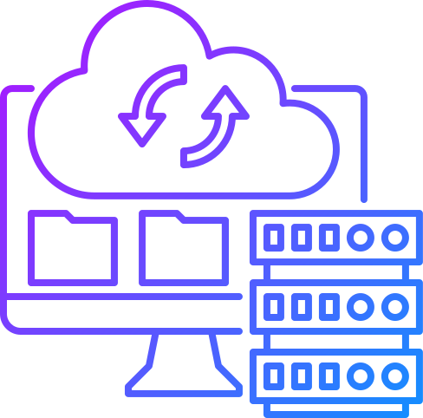
Why OS Exist?
Essential for Functionality: Without an OS, computers cannot function.
User-Friendly Interface: Simplifies interaction with complex hardware.
Efficiency: Optimizes resource use, enhancing overall performance.
nexttt!

Slide 30

Thank you for listening!

